Slide 1
Performance Operational and Multilingual Interactive Services to support Compliance for SMEs in Europe
Project Overview
PROMISLingua | www.promislingua.eu |

Slide 2
Project Scope
Project Acronym: PROMISLingua
Type of project: Pilot Type B
Project Reference: 270913
Duration: 30 months
Start date: 01/04/2011
End date: 30/09/2013
Project costs: 5.280.000 Euros
Project EU funding: 2.640.000 Euros
Funded under: The Information and Communication Technologies Policy Support Programme Area: CIP-ICT- PSP.2010.6.2 - Multilingual online services

Slide 3
Project goals
The PROMISLingua project aims at:
Translating, localising and rolling out the existing 3-lingual PROMIS® online services into six additional languages: Spanish, French, Portuguese, Greek, Romanian and Hungarian.
Delivering a cost-efficient and easy-to-use Internet based service enabling SMEs to comply with Safety, Health, Environment and Quality Regulations.
Enhancing the PROMIS ® technology system and customising it to multiple languages with online automated translation systems, Machine Translation, structuring of content, and cross text retrieval.
Deployment and roll out plans for the six additional countries to ensure take up of innovation at European level.

Slide 4
Project objectives
The project goals will be reached by:
Keeping on the forefront of technological and multilingual innovation, allowing machine translations, cross-language communication and text retrieval facility.
Structuring, translating and tailoring contents and interactive services for internationalisation.
Organising 5 workshops and preparing the rollout and deployment plans of the PROMISLingua services for the five additional countries (Greece, France, Portugal, Romania and Spain).
Setting up and concluding contracts and agreements among public and private partners, content providers, user associations and strategic alliance partners, as well as consolidating the market entry in the 4 existing countries (i.e. UK, Germany, Austria and Italy).

Slide 5
The Challenge
PROMISLingua addresses the needs of SMEs
Meeting ever increasing requirements from Health and Safety legislation, Environmental regulations and Quality performance standards at local, national, and international levels, as SMEs cannot afford appropriate personnel and financial resources to efficiently meet these demands.
Pressures from major clients and customers requiring verification of supplier performance standards.
Limited and superficial knowledge of the existing international H&S view.
SMEs mostly rely in local ad hoc processes to obtain information, updates and requirements (e.g. industry journals, sector organisations, Chambers of Commerce, etc.).
There are language barriers for SMEs intending to offer their services across Europe
“
Our challenge: extend PROMISLingua service into other languages, making use of existing language technologies, like Machine Translation, new ways of structuring of content, cross text retrieval
”

Slide 6
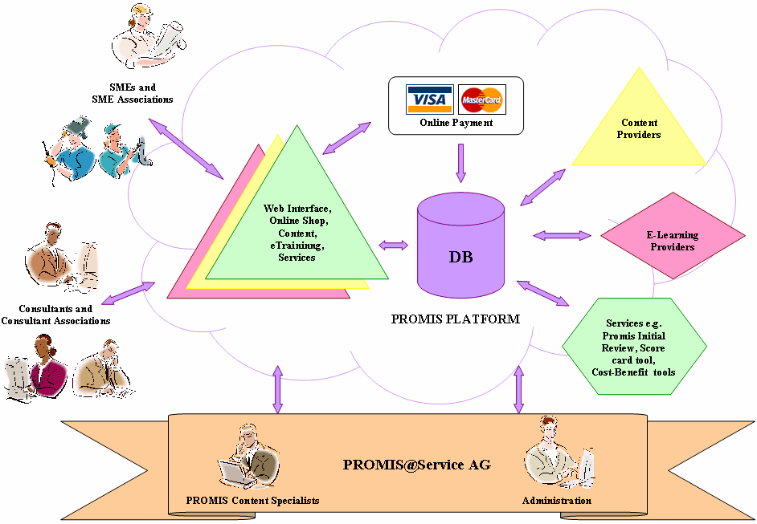
Existing Service (1)
PROMIS ® is a highly intuitive multilingual and multi-country compliance management and eBusiness vehicle offering interactive services and training to:
Support regulatory compliance
Manage and improve processes and procedures
Keep transparency and order in the organisation thanks to an adequate documentation and an integrated electronic handbook conforming with ISO 9000, ISO14000 and OHSAS requirements.

Slide 7
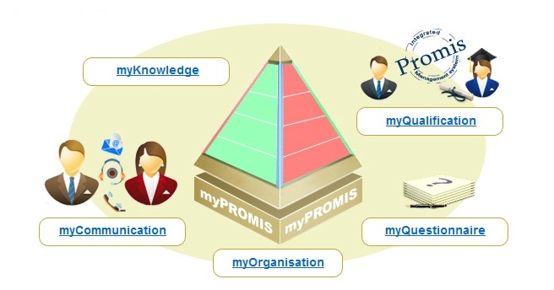
Existing Service (2)
Software as a Service
Web 2.0 Technology
The Base
myPROMIS ® : Integrated management Workspace for SMEs
myKnowledge: Workspace to structure institutional and individual knowledge
Three tool Modules
myCommunication: Online communication and remote collaboration between SMEs & Consultants
myQualification: Database for consultants’ qualification
myQuestionnaire: To develop initial reviews & tailored questionnaires
Global service and solution consisting of 56 components

Slide 8
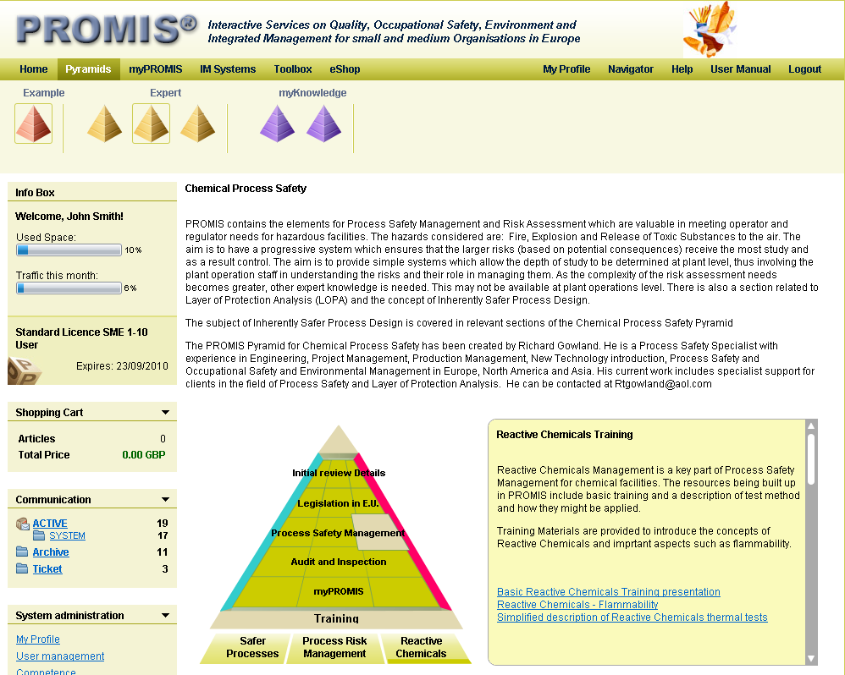
Existing Service (3)

Slide 9
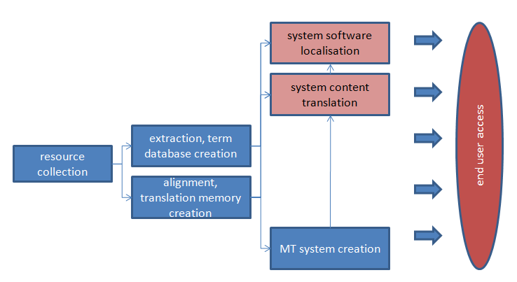
Technical solution
PROMISLingua offers an enhanced integrated management and multilingual solution to support SME compliance
Multilingualism. Natural language support are provided in two areas:
Multilingual translation tools in the area of Safety and Health and related issues
Machine Translation tools for some of the PROMISLingua languages, including collection of multilingual resources
Enhanced Translation technology for the PROMIS® Service
Knowledge repository and Integrated Management
Content and targeted languages

Slide 10
Project work plan

Slide 11
Innovation
The innovation of PROMIS® relies on:
Integrated compliance management framework, a new method to structure institutional and individual knowledge.
Supplying multilingual Health and Safety services on demand through semi-intelligent ICT tools.
Allowing SMEs to communicate in their own language and get answers to their needs online ‘at a fingertip’ in the same language.
Structuring and optimizing the increasing H&S legal content, developed either external or internally that is required for compliance.

Slide 12
Main target groups
SME owners and line-managers in SMEs, which by law are responsible for the identification and proper handling of the relevant SHEQ aspects of their company.
Consultants that provide Health and Safety & Health online consulting services optimize their business and increase the numbers of SME clients with a big economy of scale with PROMIS®.
Associations of SMEs and associations of SME-Consultants. They can offer, to their SME members, an innovative service tailored to the needs of each sector and can structure their most valuable existing content and offer it at an inexpensive cost.

Slide 13
Main outputs
The PROMISLingua pilot multilingual solution, service and content in 9 languages.
Substantial European H&S Content and Knowledge tailored to the needs of SMEs and publicly available to the SME community:
(a) for free when it comes from public institutions
(b) paid-for when it is offered by private entities and shows real value-for money.
Multilingual terminology collection in the domain of Health and Safety.
Multilingual glossary, towards harmonisation of nomenclature.

Slide 14
Key impacts (1)
Lowering language barriers
Multilingual translation tools for content translation and localisation of PROMIS® into French, Greek, Portuguese, Romanian and Spanish, in addition to the existing languages English, German and Italian
Customers Access to online content in the Health &Safety, Environment and Quality domains
Structuring of content, norms and legislation (towards EU harmonisation)
Stimulating new business opportunities
a Single Entry Point to access multilingual services supporting compliance and continuous improvement for EU SMEs businesses
sector- and theme-oriented turn key solutions for micro SMEs, with high level of trust and confidence based on security, high quality, trusted community building.
Improving the quality and effectiveness of cross-lingual communication
cost-effective and highly intuitive web-based and intranet application using standardised reference models
cross-lingual information retrieval

Slide 15
Key impacts (2)
PROMISLingua is a generic framework to build and offer interactive services which answers the requirements of the Digital Agenda in the following areas:
sector- and theme-oriented turn-key solutions for micro SMEs, with high level of trust and confidence based on security, high quality, trusted community building,
offering a balanced regulatory framework with clear rights regimes, like the PROMIS® Knowledge repository pyramid, and
a very innovative Business Model, offering adequate protection and remuneration for rights holders.

Slide 16
Partners
Organisation name
Country
Contact
INMARK (Project Coordinator)
Spain
Yolanda Ursa (yus@inmark.es)
PROMIS@Service,
Luxembourg
Caterina Berbenni-Rehm (caterina.berbenni-rehm@promisatservice.eu )
LINGUATEC
Germany
Reinhard Busch (r.busch@linguatec.de)
ATLANTIS Consulting
Greece
Christodoulos Keratidis (keratidis@atlantisresearch.gr)
INOVAMAIS
Portugal
Alfredo Silva (alfredo.silva@inovamais.pt)
INCDPM - National Research Institute for Occupational Safety
Romania
Stefan Kovacs (stefan_agk@yahoo.com)
UEAPME - European Association of Craft Small and Medium Sized Enterprises
Belgium
Timea Czirner (t.czirner@ueapme.com)
R-TECH - Steinbeis Advanced Risk Technologies
Germany
Daniel Balos (balos@risk-technologies.com)

Slide 17
Thank You
PROMISLingua Consortium
Tel- (+34) 914480203
E-mail: promislingua@teaminmark.com
www.promislingua.eu

