Slide 1
Probabilistic Adaptive Real-Time Learning And Natural Conversational Engine
Seventh Framework Programme FP7-ICT-2011-7
2011-2014
http://www.parlance-project.eu

Slide 2
Partners
University of Cambridge
Coordinator: Helen Hastie h.hastie@hw.ac.uk

Slide 3
The PARLANCE Concept
All of these skills will be learned or adapted using real data
Voice-enabled Interactive Search domain
Goal
Design and build mobile applications that approach human performance in conversational interaction, specifically in terms of the interactional skills needed

Slide 4
The Problem
Search engines are not good at eliciting follow-on information
Users typically refine queries through query reformulations which is not an efficient method
Users need full page of search results to know what to type next (takes up a lot of screen real estate)
Solution
A collaborative dialogue over several turns enabling the user to quickly and efficiently convey their search goals in context

Slide 5
Main Objectives (Skills)
O1 Develop incremental, responsive dialogue systems in 3 languages
O2 Develop personalised dialogue systems that adapt to different users with different goals in different contexts
O3 Develop dialogue systems that are dynamic and evolve
O4 Develop interactive hyper-local search

Slide 6
Example Use Case
Background: A newly married couple are driving around the city searching for a new home on a Sunday afternoon when there are typically open houses. They have some idea of what they want including near a good school.
Target User: Mobile users (hands-eyes busy) searching for properties for sale/rent. Age range 20-50. Early adopters with high disposable income possibly extending to wider section of the population.
Platform: Mobile platform such as a mobile phone or smart phone (e.g. Android/ iPhone)

Slide 7
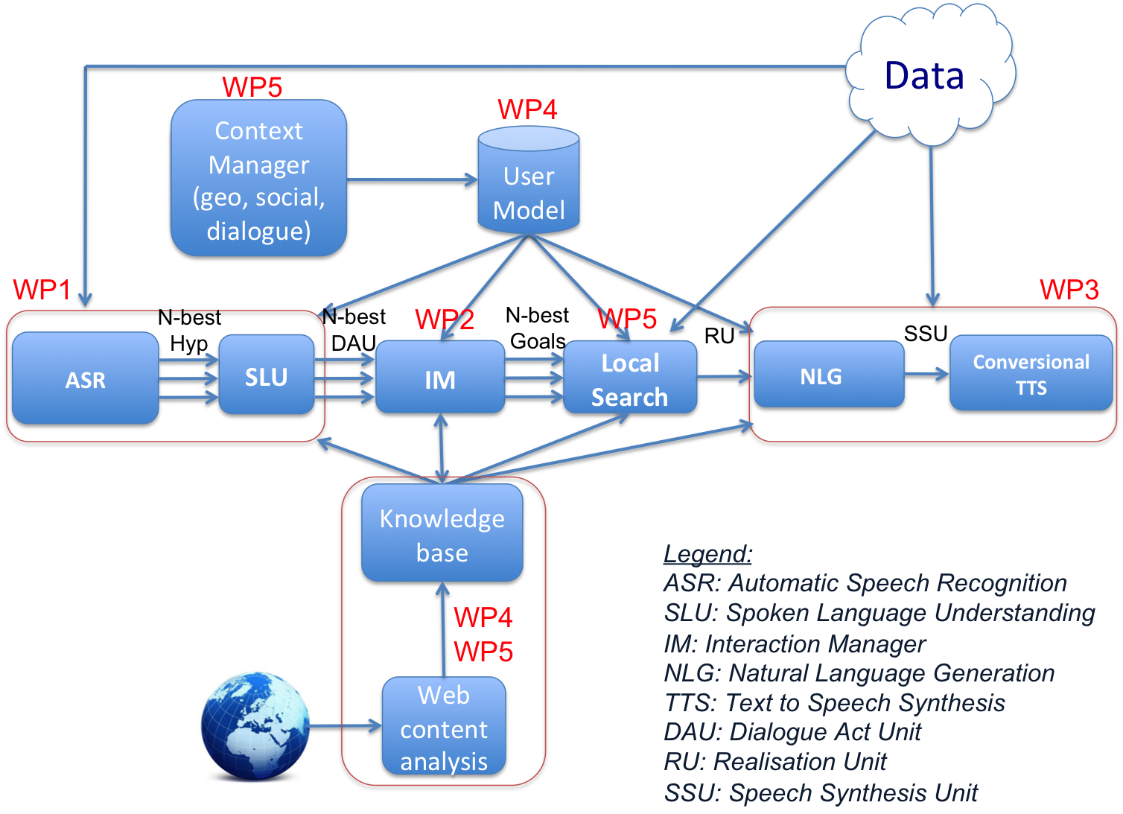
Architecture

Slide 8
Work Package 1 (RTD)
Personalised, dynamic and adaptive speech understanding
WP1 will build automatic speech recognition (ASR) and spoken language understanding (SLU) modules that support
Incrementality (O1)
Adaptation to new content (O2)
Personalisation (O3)
Lead: University of Geneva (J. Henderson)
Other participants: Cambridge, Yahoo!, Isoco
Months 1-33

Slide 9
Work Package 2 (RTD)
Personalised, dynamic and adaptive interaction management
WP2 will build an Interaction Manager (IM) that supports
Incrementality (O1)
Adaptation to new content (O2)
Personalisation (O3)
Lead: University of Cambridge (B. Thomson)
Other participants: HWU, Yahoo! CRSA
Months 1-33

Slide 10
Work Package 3 (RTD)
Personalised, dynamic and adaptive speech output
WP3 will build Natural Language Generation (NLG) and TTS Components that supports
Incrementality (O1)
Adaptation to new content (O2)
Personalisation (O3)
Lead: HWU (H. Hastie)
Other participants: Cambridge, Isoco
Months 1-33

Slide 11
Work Package 4 (RTD)
Dynamic ontologies for natural spoken interaction in open-ended domains
WP4 has two main objectives:
Build a dynamic, modular ontological knowledge base
Build and maintain a User Model
Lead: CRSA (M. A. Aufaure)
Other participants: HWU, Geneva, Cambridge, Yahoo!, Isoco
Months 1-30

Slide 12
Work Package 5 (RTD)
Interactive hyperlocal, social search for spoken dialogue systems
WP5 will provide the back-end search services that enrich and exploit the interaction with the user, with the local content, to provide a successful and satisfying interactive hyper-local search experience
Lead: Yahoo! (V. Murdock)
Other participants: Yahoo!, CRSA, Isoco
Months 1-33

Slide 13
Work Package 6 (RTD)
Requirements analysis, system integration, data collection and evaluation
WP6 has two main objectives:
Requirements analysis, architecture design and integration
Evaluation and data collection
Lead: Isoco (C. Ruiz)
Other participants: HWU, Cambridge, Geneva, CRSA, Yahoo!
Months 1-36

Slide 14
Work Package 7 (OTHER)
Dissemination and exploitation of PARLANCE
WP7 has three central objectives:
Dissemination to language technology, search, mobile devices, communities, and general public, using Internet, journal, and conference publications.
Publicly accessible web-based demonstration systems, press releases, and attendance at public science events.
Workshop or tutorial on PARLANCE research themes and results.
Lead: Isoco (C. Ruiz)
Other participants: HWU, Cambridge, Geneva, CRSA, Yahoo!
Months 1-36

Slide 15
Work Package 8 (MGT)
Project Coordination
WP8 will support the PARLANCE team to produce timely and high-quality project results through:
Technical and administrative coordination, and risk management of the entire project
Financial coordination, and ensuring we meet our contractual commitments
Web-based collaboration site
Lead: HWU (H. Hastie)
Other participants: HWU, Cambridge, Geneva, CRSA, Yahoo!
Months 1-36

Slide 16
Dissemination and Exploitation
Academic community: conferences, workshops, journal papers
Commercial/ Industry community: EC events, tutorials in an industry orientated conference (e.g. ESTC or eCHallenges)
Wider public: website, multimedia material, social media, Twitter, youTube
Dissemination and Exploitation Plan (D7.2)

Slide 17
Performance indicators
Baselines are 2011 state-of-art research and industrial SDS and components:
E.g. Current TownInfo systems (HWU/ Cam)
Success indicators:
Improved performance of PARLANCE SDS compared to baselines, using task completion, dialogue length, user satisfaction etc.
Improved performance of components compared to baselines, e.g. semantic error rates, generation quality, search precision-based metrics

Slide 18
Expected Impact
More natural, incremental systems
impact in the scientific community
faster adoption of SDS into the marketplace
Change method of information access
e.g., developing countries with non-smart phones can access web-based information
Impact on the economy: multilingual digital market
improved services to citizens and businesses across language barriers
make small businesses more visible

Slide 19
developing mobile, interactive, hyper-local search
Thank you to our funders

