Slide 1
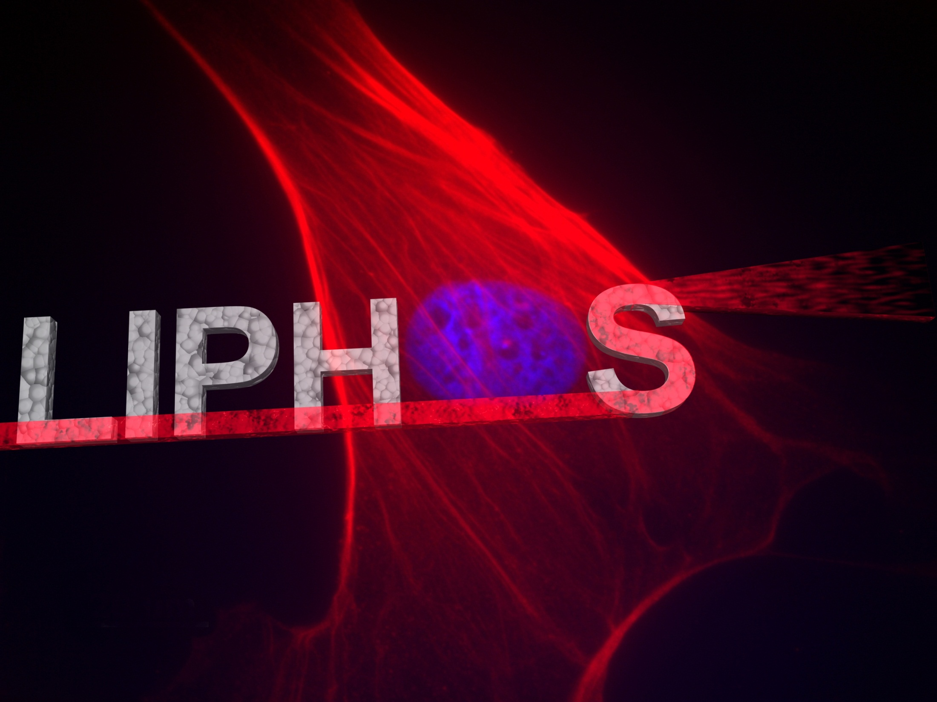
FP7/2007-2013-317916
Andreu Llobera (LiPhos Coordinator)
Presentation prepared for Cordis
Presentation accessible by CORDIS

Slide 2
Consortium
Participant No. and contactiong person | Participant Organisation Name | Participant Short Name | Country
1. Andreu Llobera | Consejo Superior de Investigaciones Científicas | CSIC-CNM | Spain
2. Sabeth Verpoorte | University of Groningen | UG | Netherlands
3. Ulf Simonsen | Aarhus University | AU | Denmark
4. Jens Ducree | Dublin City University | DCU | Ireland
5. Vicente Andrés | Fundación Centro nacional de investigaciones cardiovasculares Carlos III | CNIC | Spain
6. Dave Wenn | iXscient Ltd | iXscient | UK
7. Vivienne Williams | Cellix Ltd | CX | Ireland
8. Henk Leeuwis | Lionix BV | LX | Netherlands
Andreu.llobera@imb-cnm.csic.es
Presentation accessible by CORDIS

Slide 3
Aim: Diagnosis of Cardiovascular diseases (CVD)
CVD is a major source of mortality in the EU, with an associated financial burden of about €192 billion a year.
CVD is caused by endothelial
dysfunction in the form of
atherosclerotic disease and
inflammation, which is associated with the presence of classical vascular risk factors, including hypertension, hypercholester-
olemia, diabetes, smoking,
and aging.
Source: European Cardiovascular Disease Statistics (2008)
Andreu.llobera@imb-cnm.csic.es
Presentation accessible by CORDIS

Slide 4
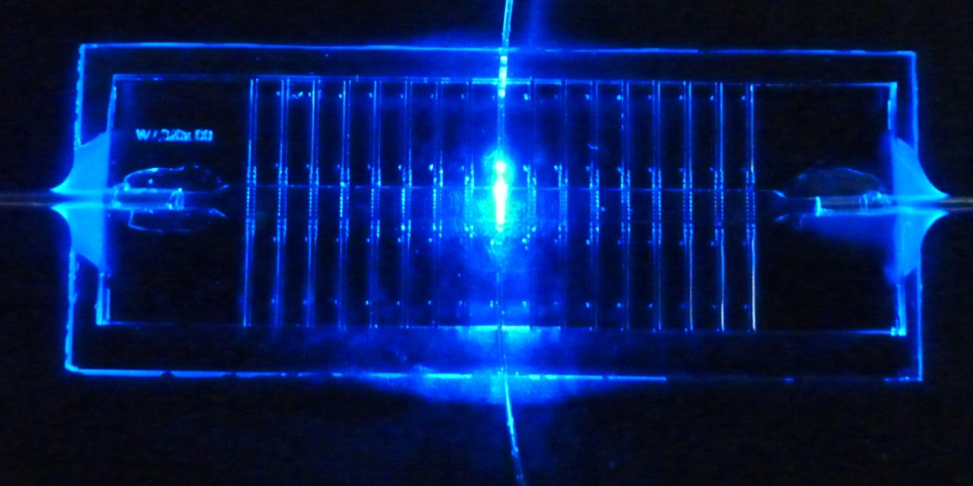
Overview
LIPHOS is focused on the development of completely innovative biophotonic diagnosis tools, which are for the first time implemented using cells as constituent material. Here, light remains confined in a waveguide whose core is uniquely composed by cells, giving rise to the “Living photonics” concept. In this context, cells play a two-fold role: i) they form a biowaveguide; ii) they are interrogated by the light coupled into them, acting as reporter elements and exhibiting a specific spectral response (photonic fingerprint).
Innovative concepts within LiPhos
Photonics:
Using cells as waveguide core in biophotonic systems.
Utilizing the PIN as a key optical parameter for cell culture identification (diagnose).
Lab-on-a-chip:
Robust benchmarking: system-level integration of photonics, microfluidics and medical cell biology.
Biomedical Sciences:
Developing an innovative methodology for the diagnosis of endothelial dysfunction, VSMC activation, and macrophage inflammation and polarization towards different subtypes.
Andreu.llobera@imb-cnm.csic.es
Presentation accessible by CORDIS

Slide 5
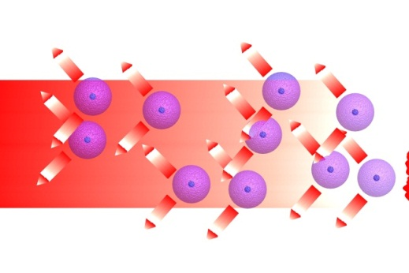
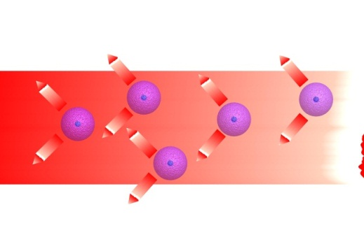
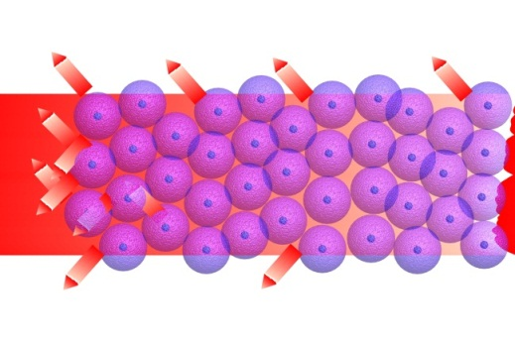
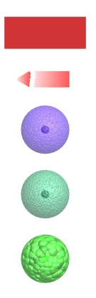
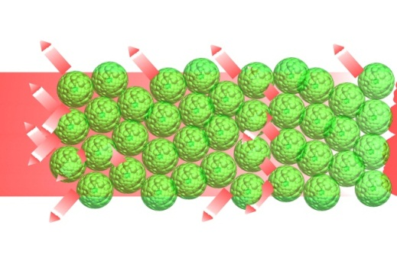
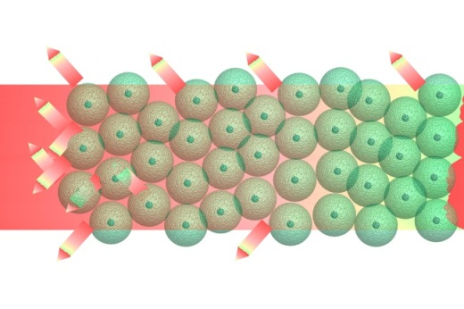
Method
Cell mortality
Seeding and lag phase
Exponential growth
Living photonics (PIN)
Legend
Light beam
Scattered light
Cells
Fluorescent cells
Modified cells
Irreversible change
Morphological variations
Label. enhancement
Reversible change
Presentation accessible by CORDIS

Slide 6
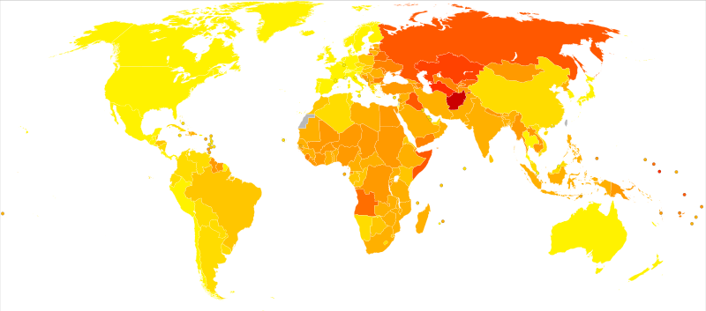
Usability of the results
LIPHOS concept and method has no known competitor, it represents an extraordinary opportunity both considering worldwide market size and savings in health care even if very conservative analysis is done (0.1% CVD reduction of the annual costs by using LIPHOS technology and protocols) it means a market of 270 million euro/year in 2020
Source: Who 2004
Presentation accessible by CORDIS

Slide 7

Acknowledgements
Project funded by the European Commission within the 7th Framework Programme (FP7/2007-2013) Grant Agreement no. 317916
Andreu.llobera@imb-cnm.csic.es
Presentation accessible by CORDIS

Slide 8
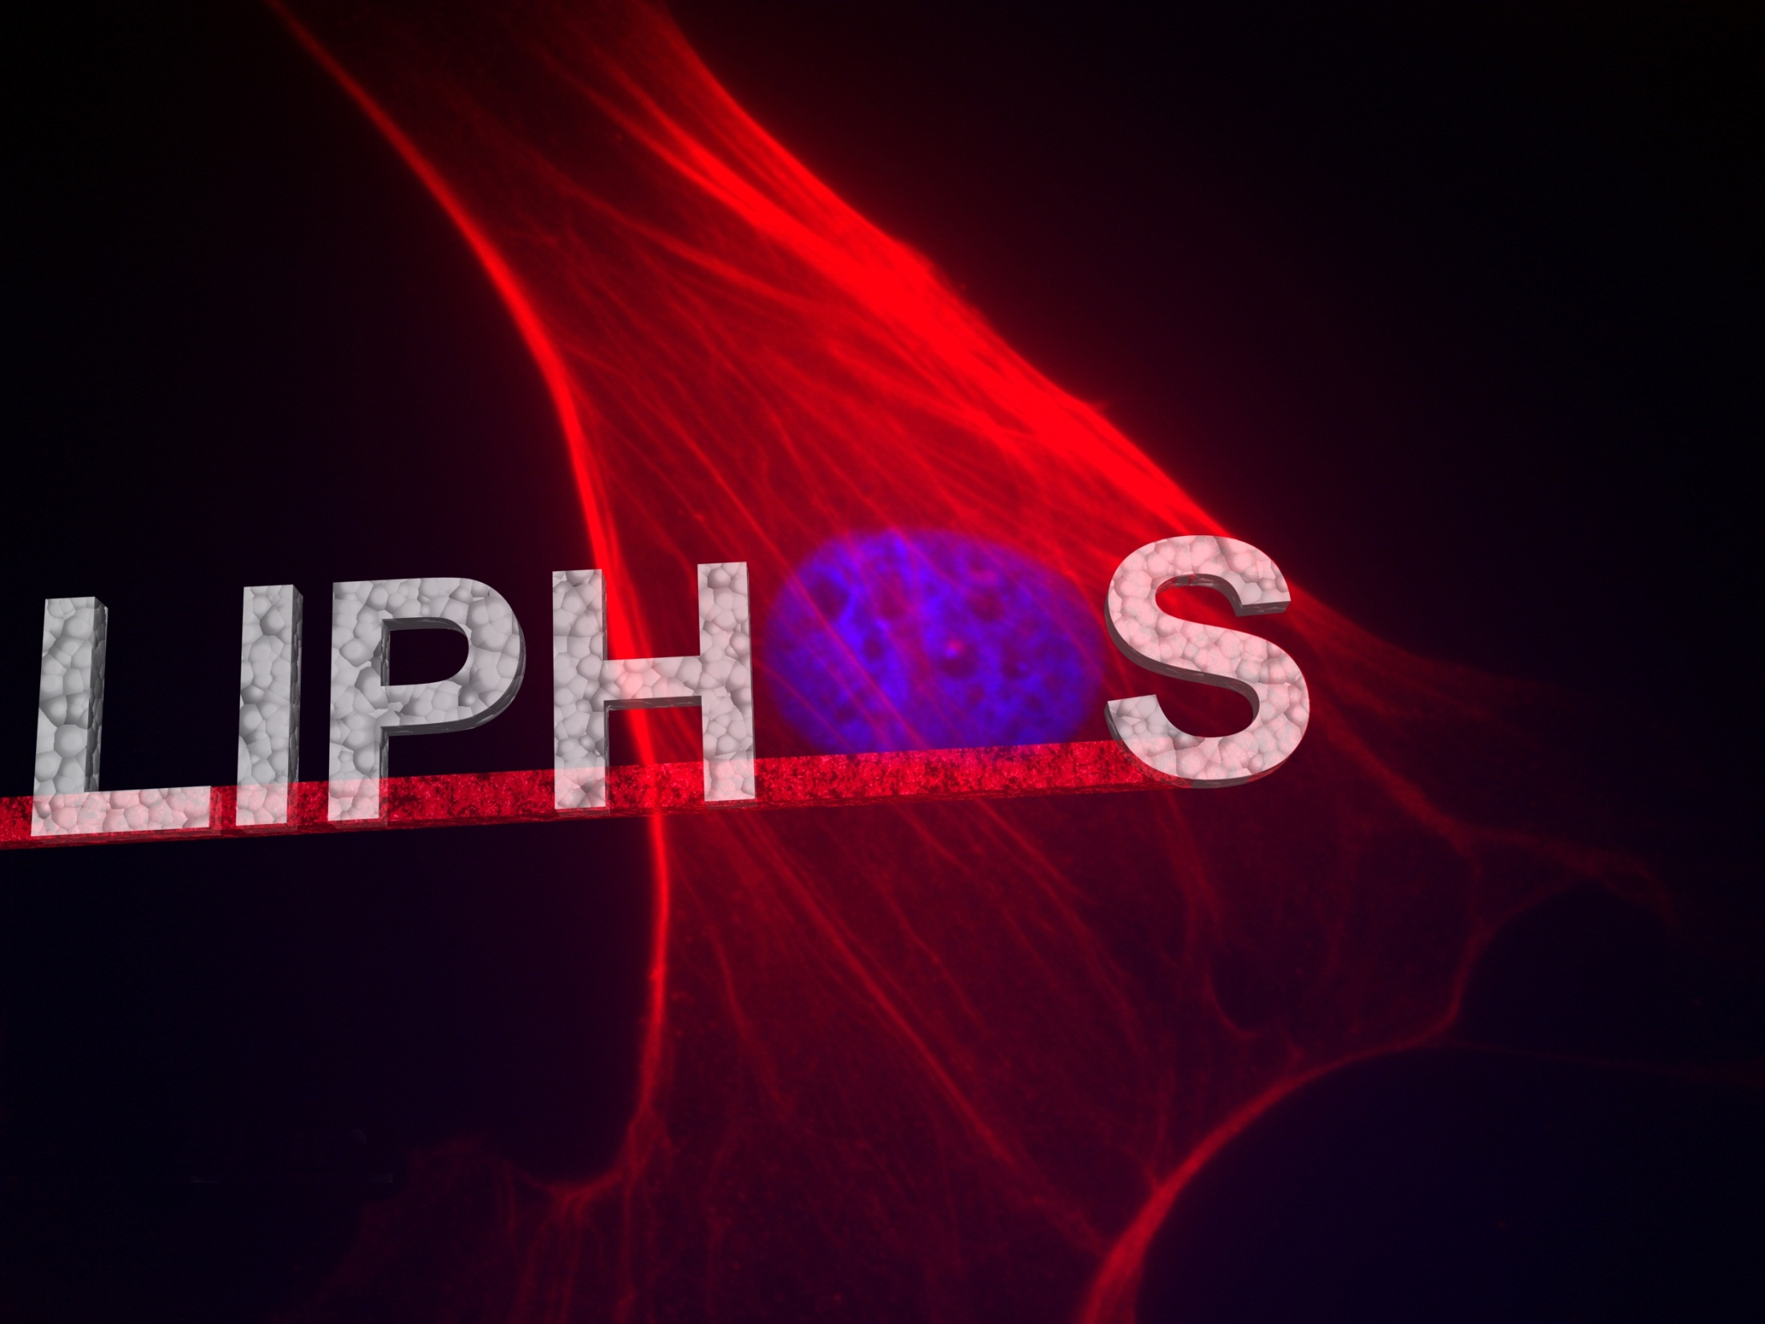
Andreu Llobera (LiPhos Coordinator)
Andreu.llobera@imb-cnm.csic.es
Andreu.llobera@imb-cnm.csic.es
Presentation accessible by CORDIS

