Slide 1
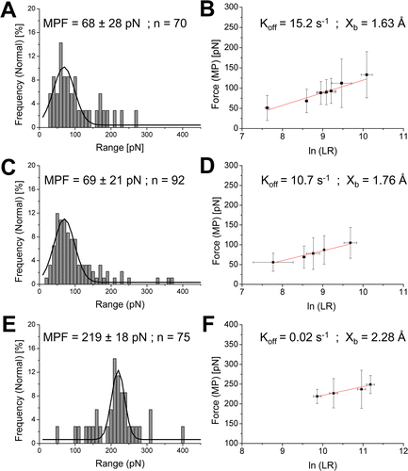
Figure 1. Histograms of pull-off force values for three different amino acids and silicon at a loading rate of 5.5 nN/s (pH 6.8). The most probable force (MPF) value was calculated on the basis of a Gaussian fit. The kinetic parameters were extrapolated from the linear-log plot of force vs loading rate: (A, B) leucine, (C, D) lysine, and (E, F) phenylalanine. The y and x error bars represent the variance of the Gaussian fit and the standard deviation of thethe apparent loading rate calculated from 10 different F–D curves, respectively.

Slide 2
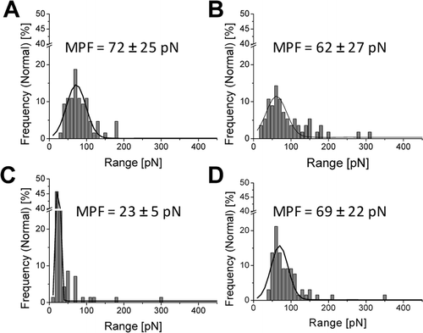
Figure 2. Force histograms at a loading rate of 5.8 nN/s for lysine and glutamate at different pH values. Force histogram for lysine at (A) pH 3.3, (B) pH 7.0, and (C) pH 11.6 and for glutamate at (D) pH 3.3. At pH 7 and 11.6, adhesion events between glutamate and silicon could not be detected.

