Slide 1
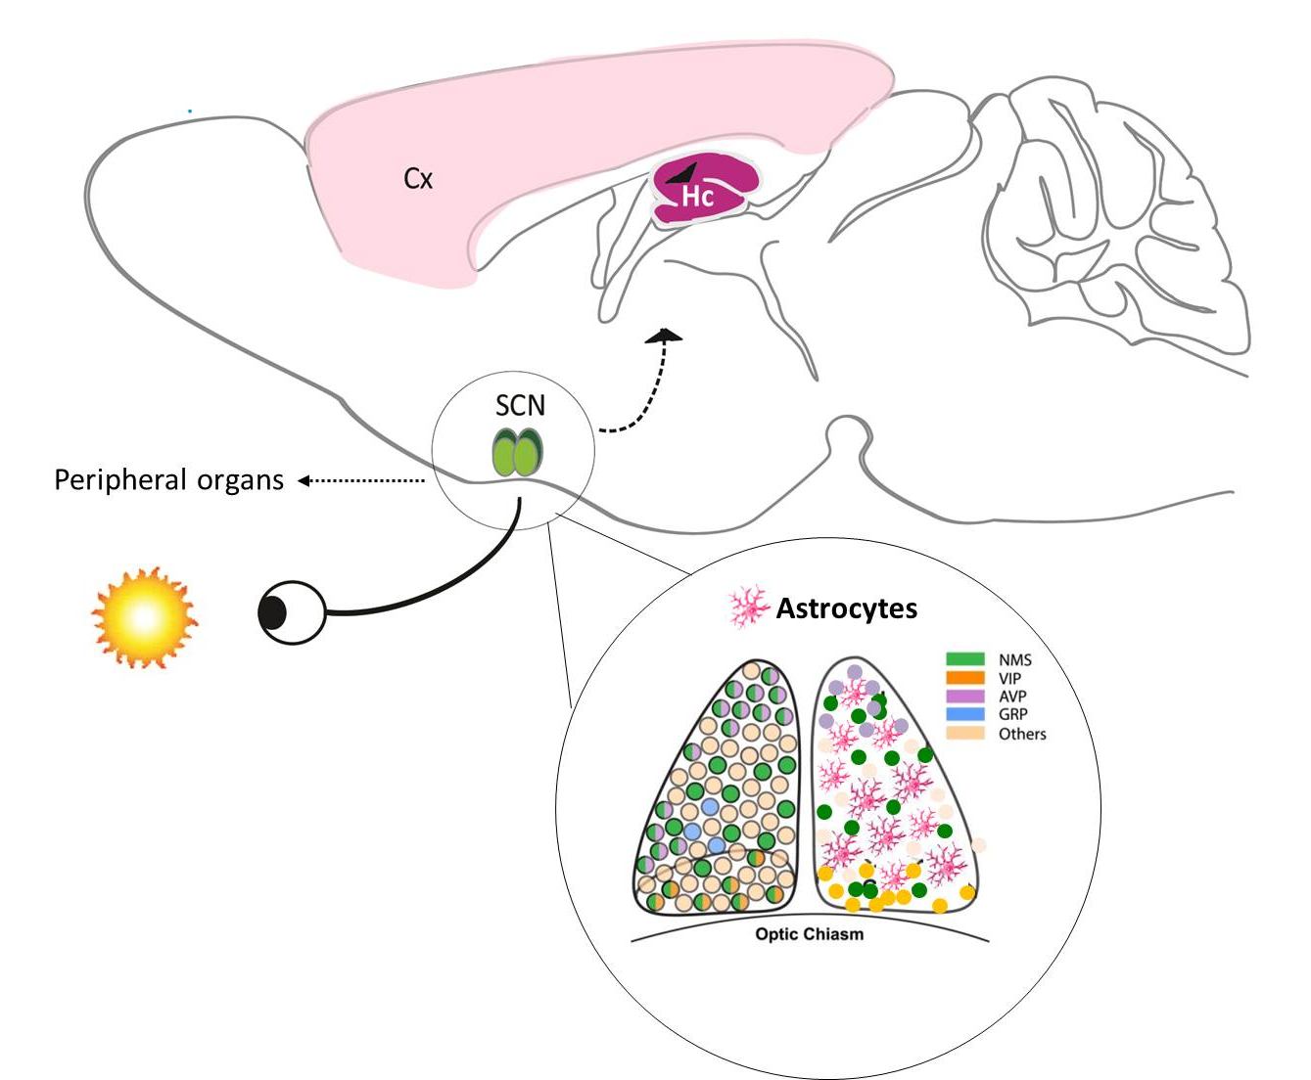
ASTROCLOCK-Olga Barca Mayo
Fig 1. Photic inputs are captured by intrinsically photosensitive retinal ganglion cells of the retina and transmitted to the central pacemaker, the suprachiasmatic nucleus (SCN). The heterogeneous population of clock neurons of the SCN (neurons expressing VIP, AVP, GRP etc) triggers autonomic and neuroendocrine signals to synchronize peripheral clocks and their corresponding rhythms in all other tissues including other regions of the brain such as cortex (Cx) and hippocampus (Hc). ASTROCLOK aimed to unravel the molecular and functional mechanisms by which “astroclock” maintain neural rhythmic behavior at cellular, tissue and organism level, from the inputs to the neurobehavioral outputs under circadian control.

